Slide 1
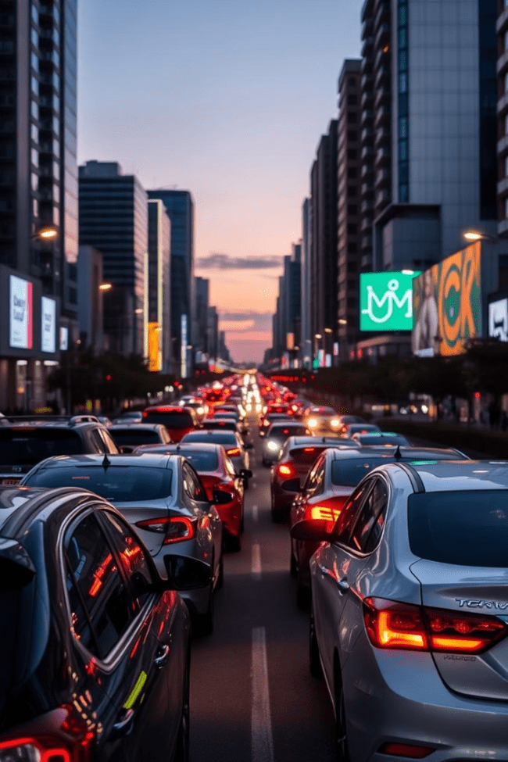
Parking Management with OpenCV
Urban areas face traffic congestion and inefficient parking usage. Traditional parking systems are costly and unreliable. Our solution uses OpenCV and Python for dynamic vehicle detection and slot management without expensive sensors or GPUs.

Slide 2

System Architecture Overview
Vehicle Detection
Noise Reduction:
Cameras capture and provide vehicle image.
Gaussian blur is applied using cv2.GaussianBlur(). This technique helps to eliminate high-frequency noise
Grayscale Conversion:
Histogram Equalization:
The first step in image processing is converting the input image into grayscale using the cv2.cvtColor() function.
To further enhance the image quality, especially under varying lighting conditions, histogram equalization is performed using cv2.equalizeHist().
Implemented with Python, OpenCV, and efficient data structures like Grayscale Conversion,Histogram Equalization,ORB (Oriented FAST and Rotated BRIEF.

Slide 3
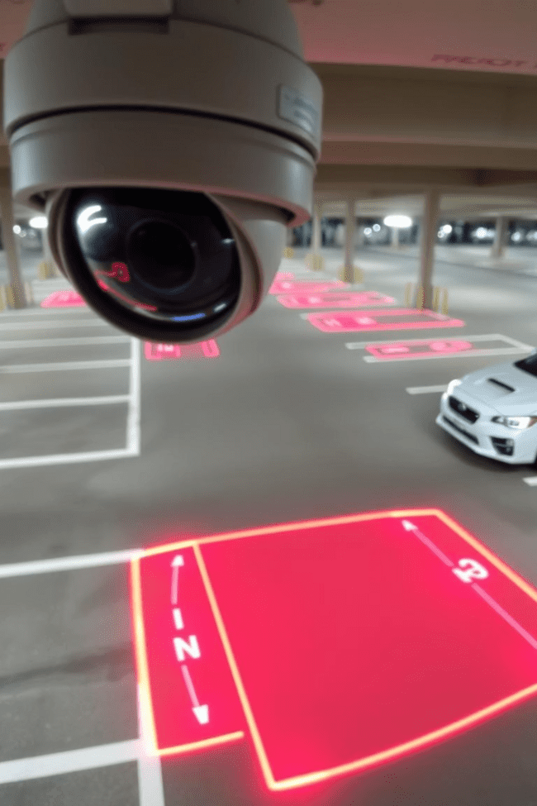
Vehicle Detection Module
Image and Video Capture
Uses Vehicle Detection Dataset.
Preprocessing:
Grayscale conversion → Gaussian blur → Histogram equalization
Feature Extraction:
ORB for keypoints → Perspective correction (optional). Edge Detection: Canny edge detection (cv2.Canny).
Contour Detection
Detects vehicle outlines for validation.

Slide 4
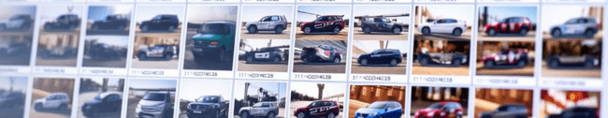
Dataset Description
Real-World Images
Training Set
Test Set
High-resolution photos for diverse vehicle types.
Includes labeled bounding boxes in CSV format.
Unlabeled images for model validation.

Slide 5
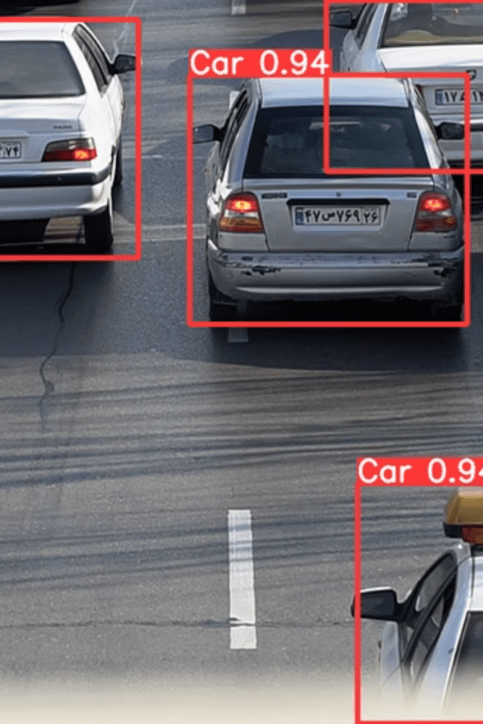
Image Processing Workflow
1
Preprocessing
Grayscale conversion, blurring, and equalization
2
Feature Extraction
ORB keypoints highlight key image features
3
Perspective Correction
Optional step to align image plane
4
Edge Detection
Uses Canny algorithm for sharp edges

Slide 6
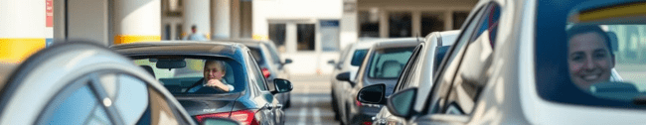




Results and Advantages
Real-time
Cost-effective
Scalable
Versatile
Immediate vehicle detection and slot allocation
Runs on low-cost devices without sensors or GPUs
Easily integrates with cloud and IoT systems
Suitable for malls, offices, and residential areas

Slide 7
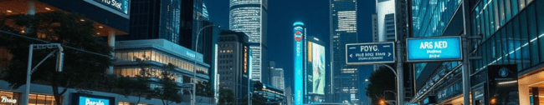
Conclusion
Practical solution
Scalable integration
Bridging systems
Classical vision techniques minimize cost and complexity
Ready for adoption in smart city infrastructure
Combines traditional surveillance with intelligent transport

Slide 8
Future Scope
Timestamp Billing
License Plate Recognition
Real-Time Alerts
IoT and Cloud Integration
Automate parking fee calculation by entry and exit times.
Send notifications for parking status and violations.
Integrate OCR for vehicle identification and security.
Enable city-wide management and data analytics.

